Slide 1
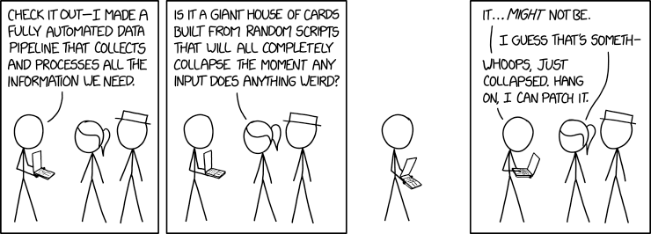
CSE 445: Machine Learning
Machine Learning Project – Data Exploration
Image taken from xkcd

Slide 2
Steps in an ML Project
Look at the big picture
Get the data
Visualize data for insights
Preprocess the data
Select a model and train it
Fine-tune your model
Present solution
Launch!

Slide 3
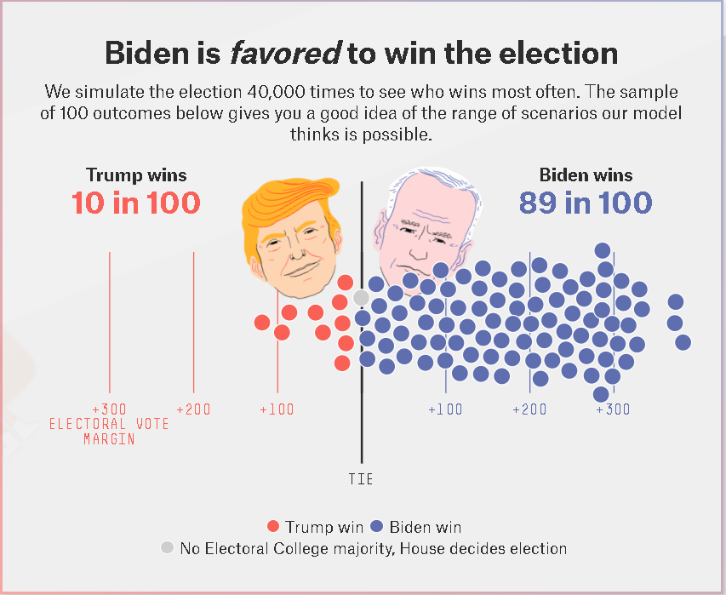
Prediction gone wrong?
Source: fivethirtyeight

Slide 4
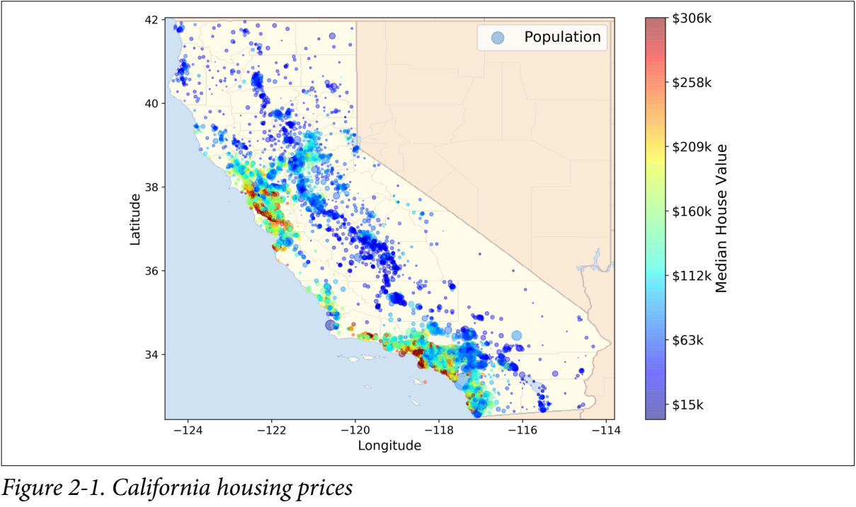
Example Problem: California Housing
Objective: Use census data from California to build a model of housing prices
Source: StatLib repository

Slide 5
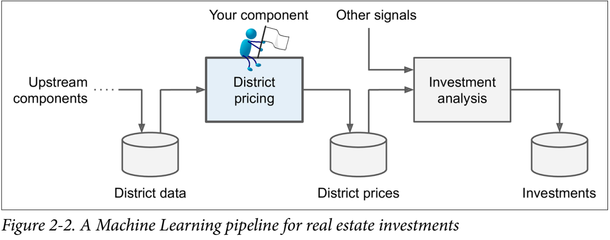
Frame the Problem
Task: Predict median housing price in ANY district in CA, given all other metrics
Dataset includes metrics such as population, median household income, total rooms etc – as well as the median housing price in a district
Model output will go in as a signal to decide whether to invest in a given area
Data Pipeline for District pricing project

Slide 6
What type of Problem is it?
Supervised, unsupervised, reinforcement?
We have the labeled training examples – the median housing price is included in the dataset. We can use Supervised Learning!
Classification or Regression?
The desired output is a continuous variable – this is a regression task
Multiple features available - it’s a multiple regression problem
Only one value to be predicted – univariate regression problem
Batch Learning or Online Learning?
No incoming data other than dataset – batch learning is fine

Slide 7
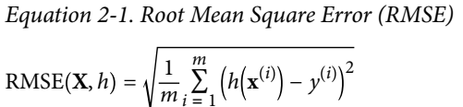
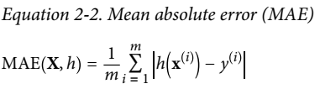
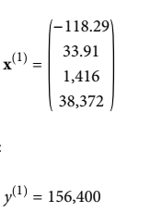
Performance Measure
Root Mean Square Error (RMSE) or Mean Absolute Error (MAE)
m - number of instances in the dataset
x^{(i)} – vector of all feature values for instance i and y^{(i)} – label value for instance i
X- matrix containing all feature values (excluding the labels) of all instances in dataset
h – system’s hypothesis/prediction function/weights
RMSE(X,h) or MAE(X,h) – cost function measured on set of examples using your hypothesis h

Slide 8
Performance Measure
Error – i.e. the difference between true label value y and the predicted label value computed as h(x^{(i)})
RMSE and MAE are two ways to measure the distance between two vectors – namely, the distance between your predicted labels, and the true label value
RMSE – straight line distance, or Euclidean norm, or L2 norm
MAE – city block distance, or Manhattan norm, or L1 norm
Higher norm index → more sensitive to outliers

Slide 9
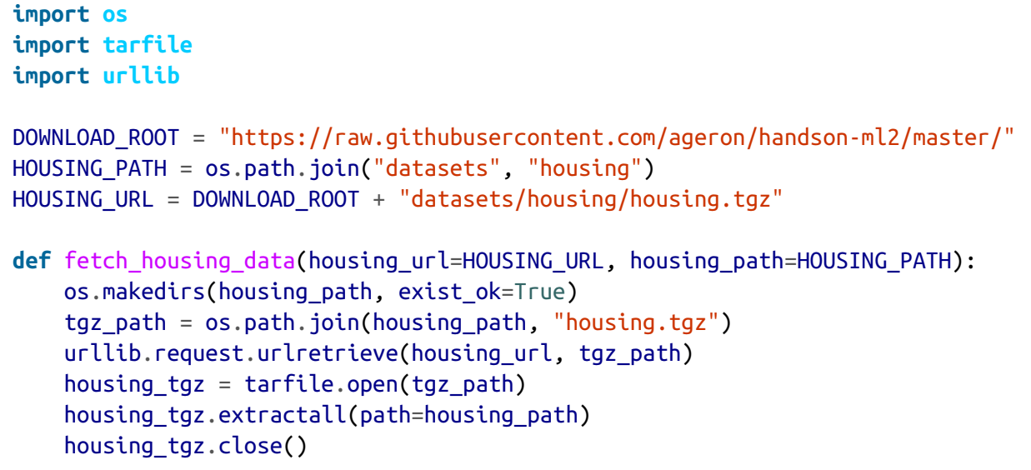
Download Data
Automate process of fetching data because
It’s useful if the data changes regularly (can schedule this)
Can install on multiple machines

Slide 10
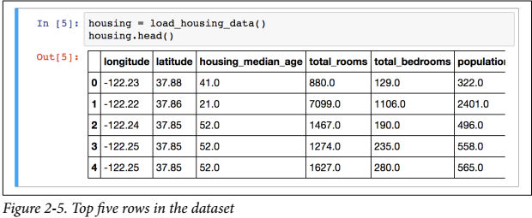
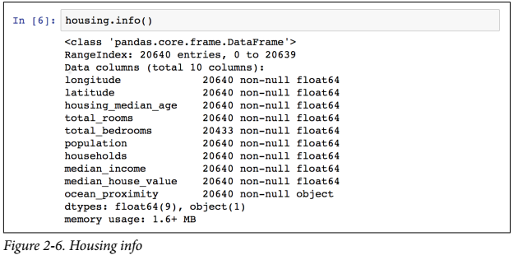
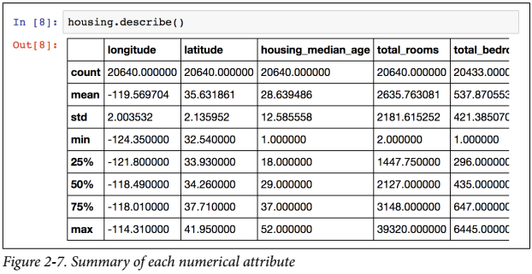
Quick Look at Data Structure
Each row represents 1 district (i.e. 1 instance)
Ten features (attributes)
Total instances = 20,640 in the dataset

Slide 11
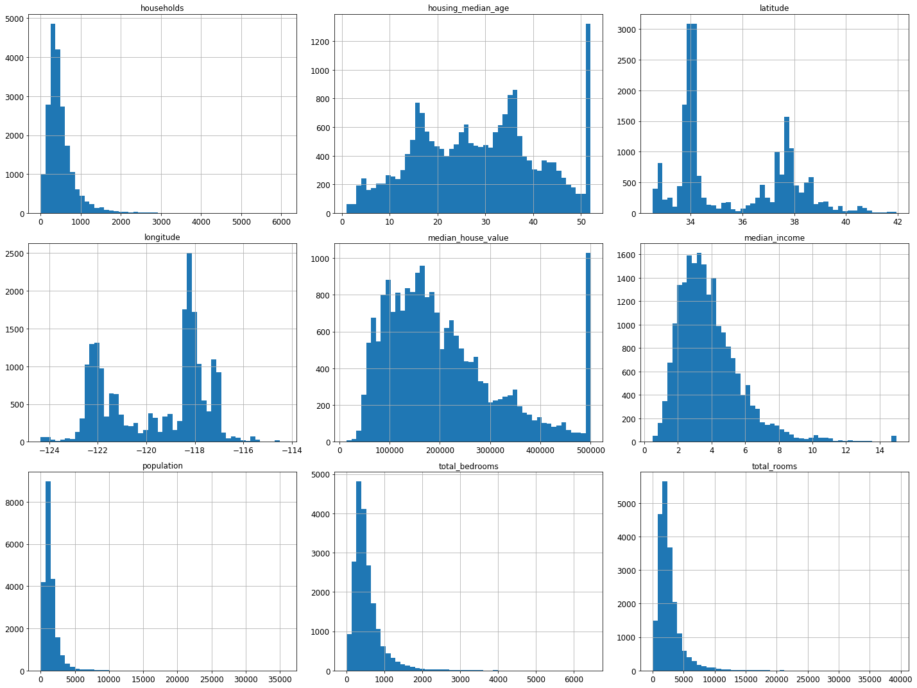

Histogram
Plot a histogram for each numerical attribute
Noticeable oddities:
Preprocessed Features – median income isn’t in raw USD, but has been scaled by a factor of 10,000 and capped to 15
Output (i.e. median house value) has also been capped – ere go, will not be able to predict beyond $500,000!
Tail-heavy histogram

Slide 12
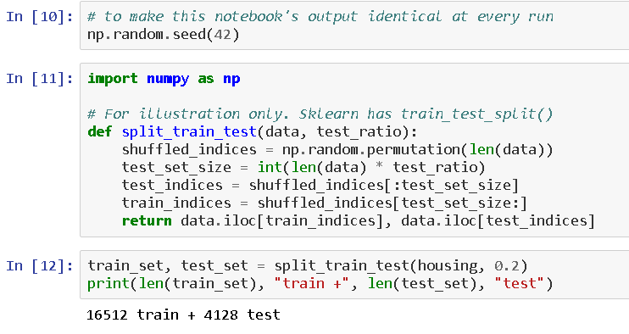
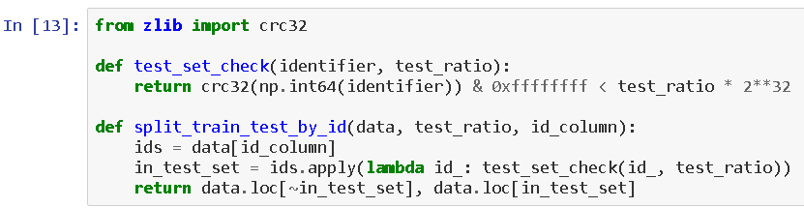
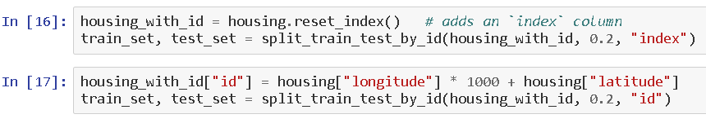
Test Set Generation – Random Sampling
Create and set aside the test set as early as possible! (Data Snooping bias)
Use random seed generator to ensure same shuffled indices (if your dataset updates, this alone will not work!)
Compute a hash of each instance and put in test set if it’s less than or equal to 20% of max hash value (ensures consistency across multiple runs)

Slide 13
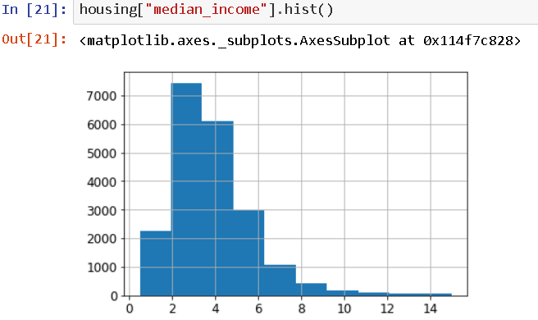
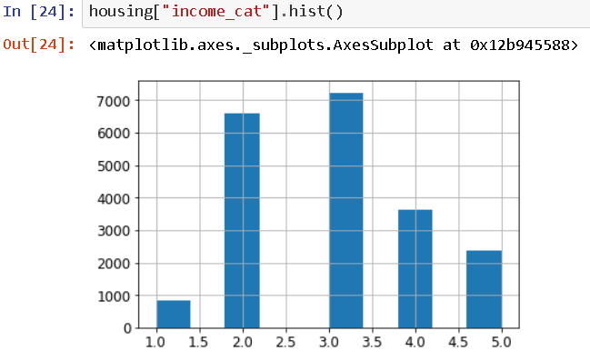
Stratified Sampling
Need to have a test set that is representative of the overall population
Strata – homogenous subgroups
e.g. male to female ratio in Bangladesh is 103 to 100
Stratified sampling – ensuring test set is representative of overall population
Test set should have 103 males for every 100 females

Slide 14
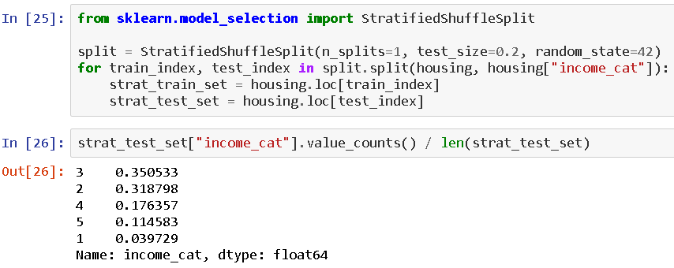
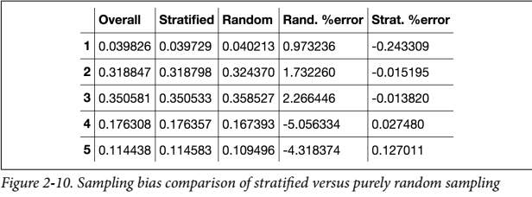
Stratified Sampling
Without Stratified Sampling, the sampling bias in the test set is generally much higher
We want the test set data to resemble the real world data

Slide 15
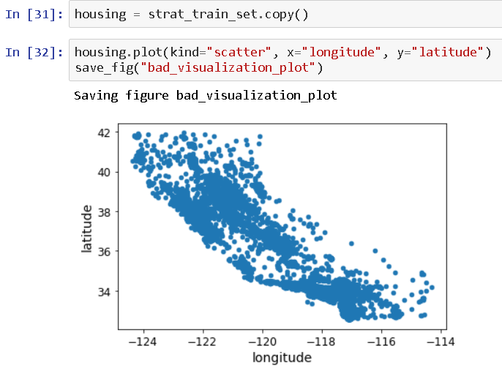
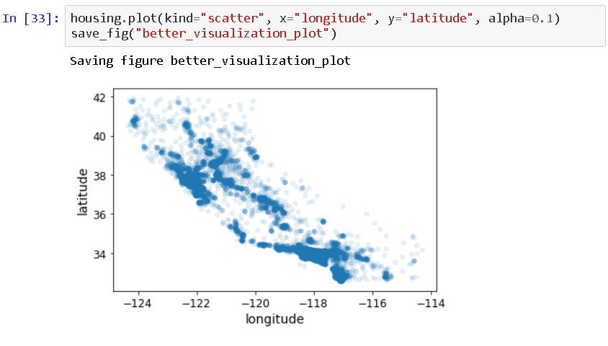
Data Visualization
Use latitude and longitude to visualize the district locations
Bad Visualization
Slightly Better Visualization

Slide 16
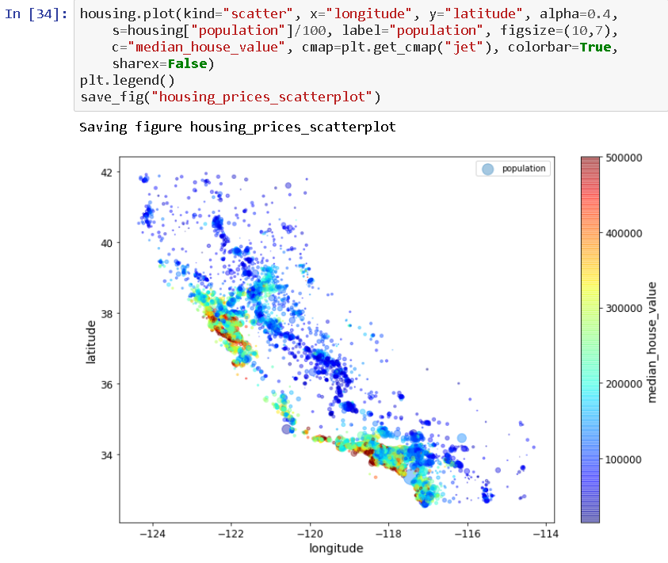
Data Visualization
Best visualization – show median house value using color!
Can see high value around metro areas near the ocean (LA, SF, SD etc)
Note: Only do this for training set!

Slide 17
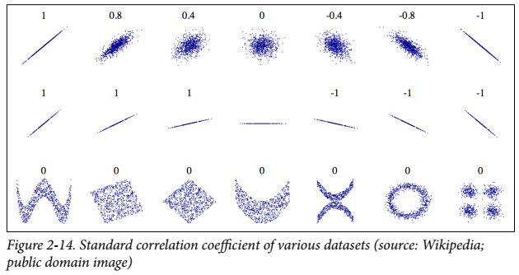
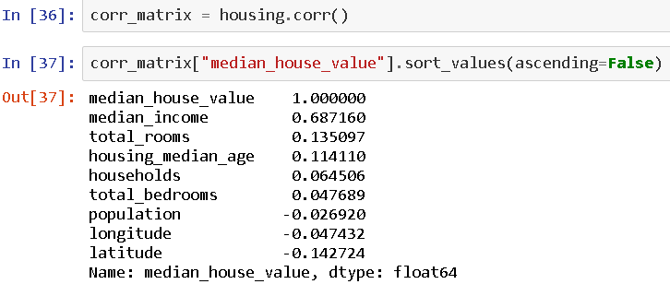
Correlation between attributes
Correlation coefficient near 1 → Strong Positive Correlation
If x goes up, y goes up too
Correlation coefficient near -1 → Strong negative correlation
If x goes up, y goes down
Correlation coefficient near 0 → no linear correlation
Doesn’t mean there’s no relationship between the two!
Note: The size of the slope has nothing to do with how correlated the two attributes are!
In case of housing dataset, median house value is positively correlated to median income (as expected)

Slide 18
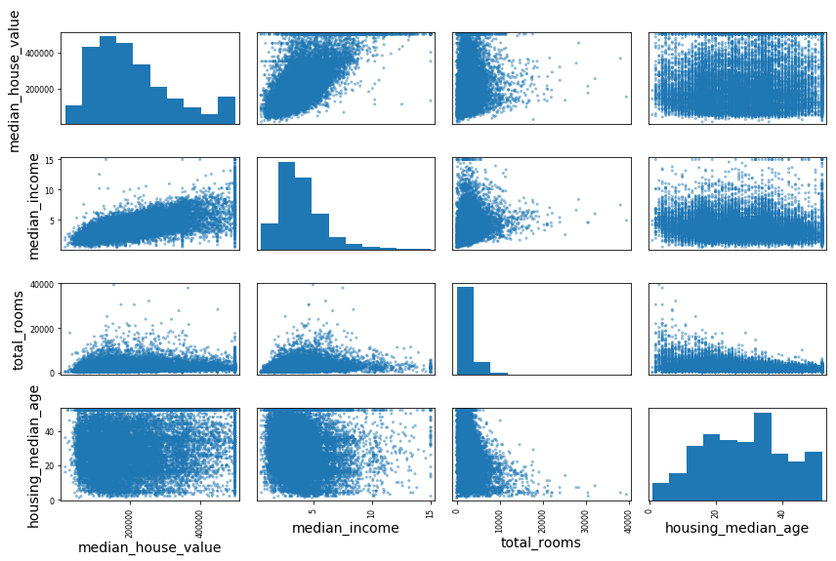
Scatter matrix visualization of Correlation
Main diagonal has each attributes’ histogram generated by the pandas library (instead of a perfectly correlated straight line)
Look for patterns in each attribute pair
Correlation coefficient with median house value

Slide 19
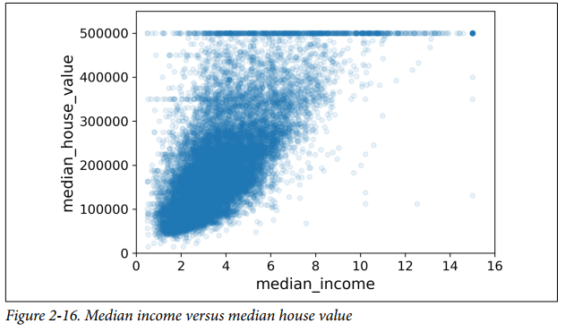

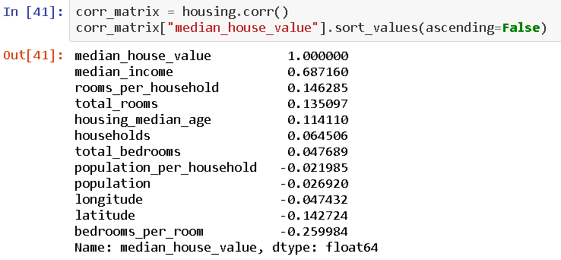
Attribute Combinations
Upward trend visible – and the points are not too dispersed
Price cap visible at 500,000
Horizontal lines at 450,000, 350,000, and 280,000 (Why?)
Algorithm may pick up and reproduce these quirks
Consider other attribute combinations – may be more revealing!
Rooms per household, bedrooms per room, and population per household more correlated to house value than total rooms, households, or population alone!

Slide 20
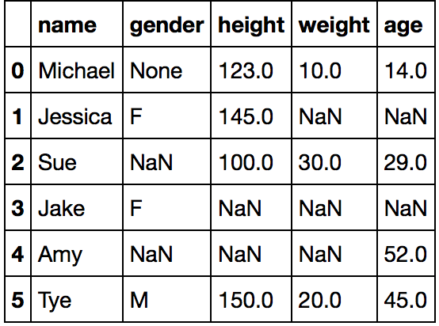


Missing Data - Numerical
Option 1: Remove instances (rows) that contain missing data [ dropna() in pandas]
Can work if there aren’t too many instances with missing data
Option 2: Remove the entire attribute (column) with missing data [ drop() in pandas]
Worse than option 1, especially if it’s a useful attribute when available!
Option 3: Set values to some statistical measure (zero, mean, median, etc) [ fillna() in pandas]
Only do this on training set – replace later in test set during evaluation
Use SimpleImputer in Scikit-Learn to streamline this process

Slide 21
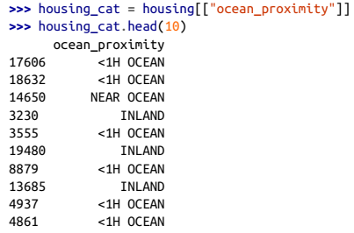
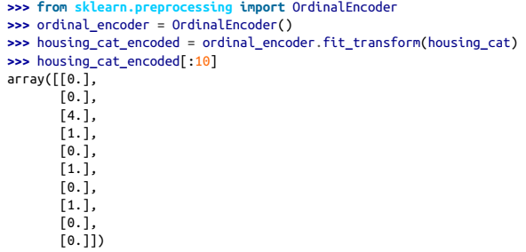

Text and Categorical Attributes
Discrete, non-arbitrary text values – category
Convert categorical values from text to numbers
Option 1: Map each category to a unique number
ML algorithm may assume (incorrectly) that two “nearby” values are more similar than two distant values
<1H OCEAN and NEAR OCEAN encoded as 0 and 4 – even though they’re more similar to each other than INLAND (encoded to 1)
Only use this if the categories are ordered

Slide 22
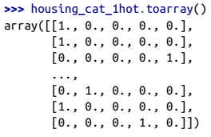
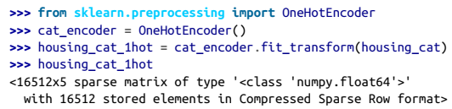

Text and Categorical Attributes
Option 2: One hot encoding – one dummy binary attribute per category
Sparse matrix with nonzero element location generated
May degrade performance if there are too many categories – consider replacing with useful numeric features related to categories if possible

Slide 23
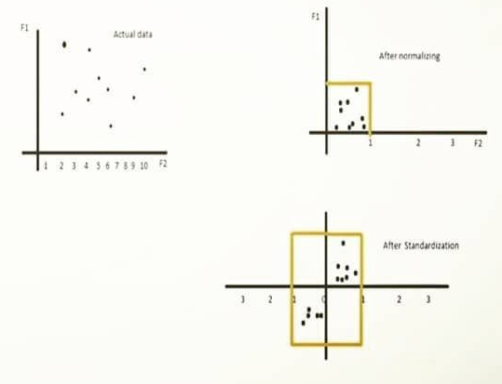


Feature Scaling
Usually, ML systems don’t perform well if input attributes have very different scales
In housing data, total # of rooms → 6 to 39,320, whereas Median Income → 0 to 15
Normalization →shift and rescale values so they range from 0 (minimum value) and 1 (maximum value)
Might be adversely affected by outliers
Standardization → subtract the mean value, and divide by standard deviation so that the resulting distribution has zero mean, and unit variance
Not bound to a specific range (could be problematic for some algorithms such as NNs)
Normalization: $x=\frac{x−xmin}{xmax−xmin}$
Standardization: $x=\frac{x−µ}{σ}$

Slide 24
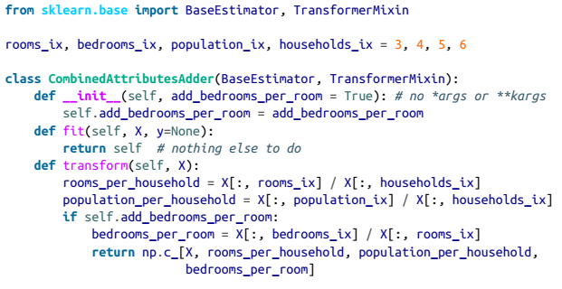
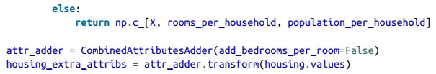
Custom Transformers
Scikit-Learn relies on duck typing → create a class and implement three methods: fit(), transform(), and fit_transform()
just add TransformerMixin as a base class to get fit_transform()
Adding BaseEstimator gives you two extra methods: get_params() and set_params()
Consider the following → add the custom parameter bedrooms_per_room to the set of input attributes
One hyperparameter in the form of add_bedrooms_per_room

Slide 25
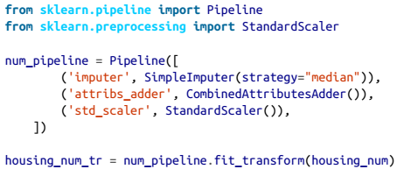
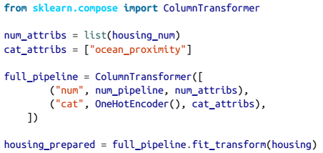
Pipeline
Ensure data transformation steps are executed in the right order
Pipeline constructor → take list of name/estimator pairs in sequence
Column transformer→ handle numerical and categorical data together
housing_prepared contains data ready for training

Slide 26

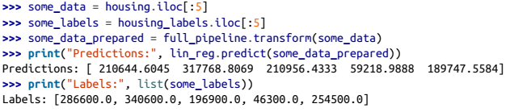
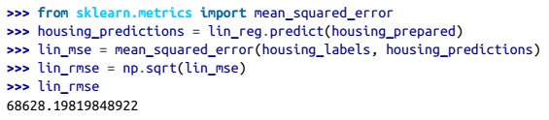
Training – Linear Regression
Import LinearRegression and fit to prepared training data and corresponding labels
Predictions are not exactly accurate
RMSE is $68,628 – better than nothing, but not great!
Model is underfitting the data – model isn’t powerful enough/need better features/reduce constraints

Slide 27

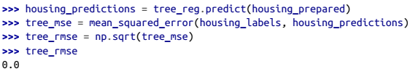
Training – Decision Tree Regression
Decision Trees → more powerful than Linear Regression
DTR can find complex, nonlinear relationships in the data – something linear regression is not capable of doing by definition
No error in between housing labels and housing predictions?
Tendency to overfit the data – need model validation!
Note: Decision Trees often look great during the training phase, and fail miserably in validation/testing. Don’t jump to conclusions too quickly!

Slide 28

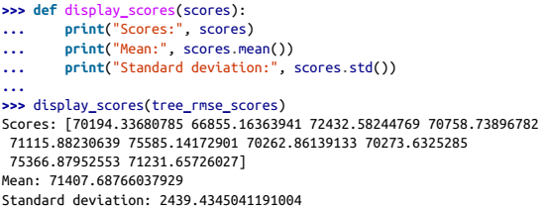
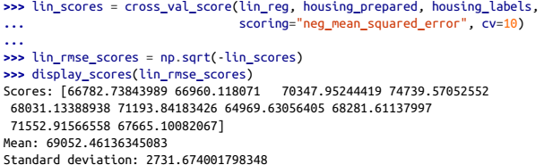
Validation
Option 1: Single Validation set
Use train_test_split to divide training set into training+validation
Train your model with the smaller training set, and evaluate them against validation set
Option 2: K-fold cross-validation
Randonly split training set into K subsets, or folds - train and evaluate model K times, picking one fold for eval and training on the rest
Better to do this, especially if you have a small dataset
Lin Reg model actually does better than the Decision Tree model!

Slide 29
Fine Tuning Models
Grid Search
Specify hyperparameters to experiment with
Use cross validation to evaluate all possible combinations
Randomized Search
Useful when hyperparameter search space is large
More control over computing budget – set number of iterations
Ensemble Methods
Group of models often work better than a single individual model
Analyze the best models (and features) and their errors – then predict on the test set

Slide 30
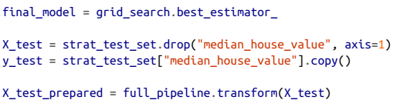

Evaluation on Test Set
Get predictors and labels from test set, set into pipeline, and evaluate!
Performance may be (and often is) worse than what was measured in cross validation
Final performance of system for housing data is comparable to human experts (but not better – still worth it!)

Slide 31
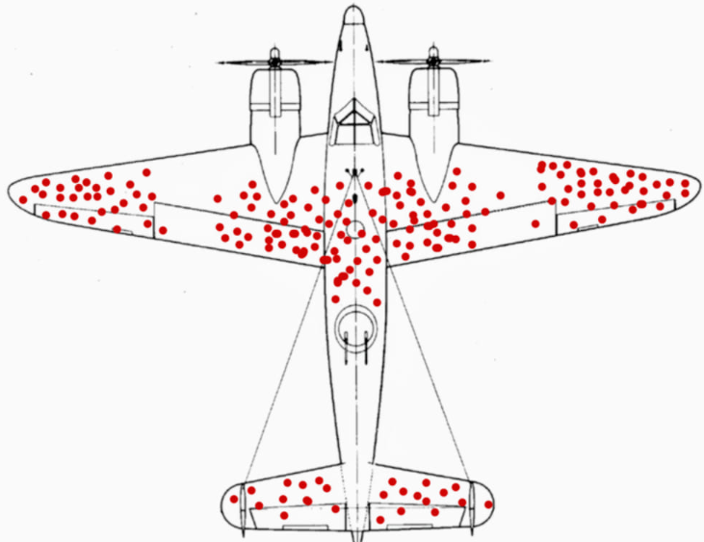
Check your Bias
During WW2, Allied Forces ran an analysis on airplanes that took bullets during combat
They wanted to figure out where planes were most vulnerable and needed armor
The red dots are bullet holes observed in planes that returned from combat
Where would YOU increase armor?

